Slide 1
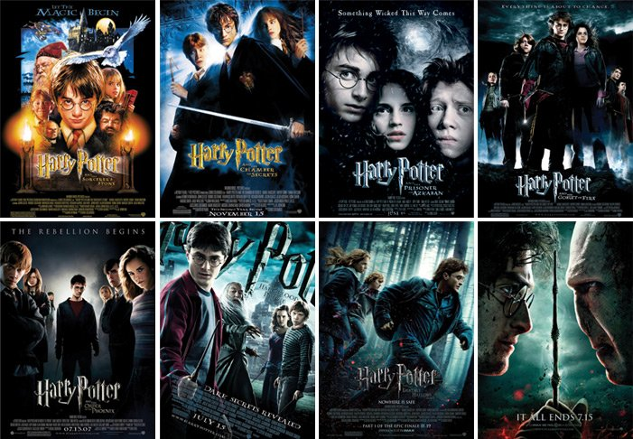
The Harry Potter series
Harry Potter Throughout the Years and it’s Significance in Film History

Slide 2
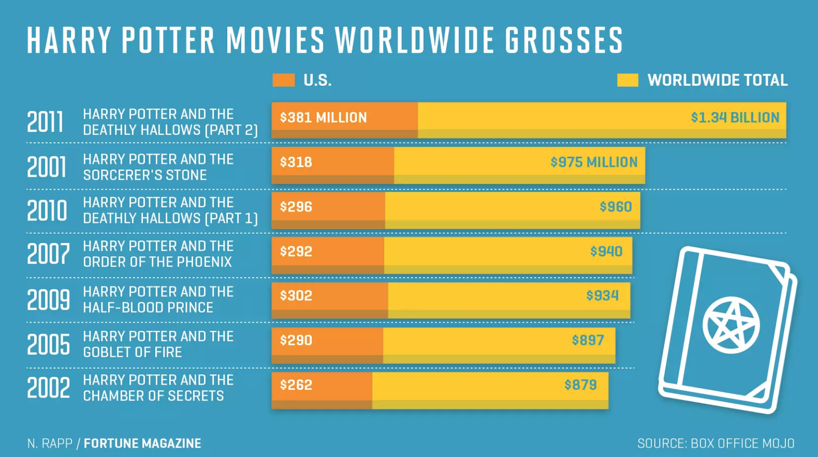
The Stats
- 3rd highest-grossing film series in the world
- 5/8 films in ’50 highest-grossing films of all times’ list
    —> Harry Potter and the Deathly Hollows- Part 2 : $1.3 billion (nr. 8 on the list)
- 3rd highest-grossing film series in the world—> Box office total: $ 8.5 billion

Slide 3
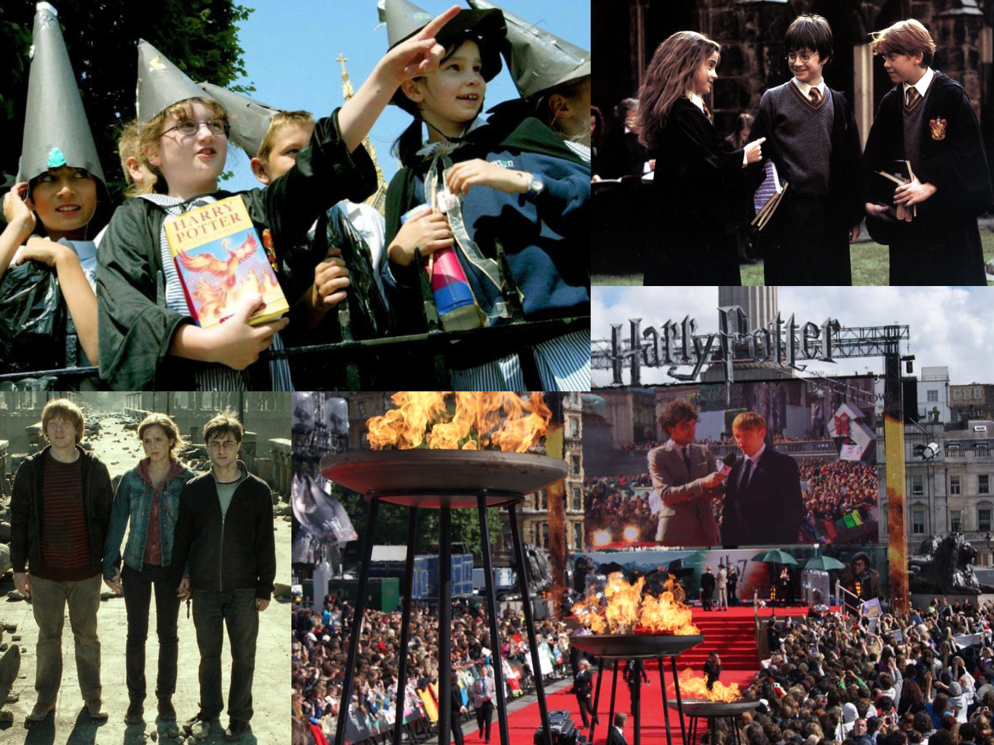

Slide 4
Harry Potter Throughout the Years
Film series from 2001 - 2011, gaining scale as years passed
Directed by four different directors:
    Chris Columbus (1–2) : pure magic, exciting, lighter in tone (they are still young children), introducing and establishing the Wizarding World
    Alfonso Cuarón (3): as protagonists mature, films themes become more complex
    Mike Newell (4): teenage, coming of age topics, humorous but significantly darker tone
    David Yates (5–8): dark, political/social/ cultural themes (strong parallels between Voldemort and the death- eaters pursuing ‘master race’ —>Hitler and Nazis)

Slide 5
VFX Technology Throughout the Years
Ian Failes, in article for Inverse Magazine “How the Magic of 'Harry Potter' Revolutionised Visual Effects.” describes the significant visual effects evolution in the HP films —> “From Hogwarts minis to lifelike Quidditch”
Sorcerer’s Stone (2001): exterior views of Hogwarts achieved through a giant miniatures set
Chamber of Secrets (2002): real car was built and filmed on a studio location to simulate the flying car
Prisoner of Azkaban (2004): to create imaginary creature, Hippogriff Buckbeak, a hydraulic-rig was filmed against green screen to simulate movements, fur and feathers were added digitally in post
Goblet of Fire (2005): dragon and broom chase build digitally, Voldemort
Order of the Phoenix (2007): Dumbledor and Voldemort’s fight with water, glass and fire in the ministry of magic, VFX digitally constructed
Half-Blood Prince (2009): Quidditch now constructed digitally, blue-screens, broomstick gimbles, real photography
Deathly Hallows – Part 1: CG ‘Doby’ character, completely digital and real sized body-double with sub-surface skin technology to create realistic cloth movement
Deathly Hallows – Part 2: Double Negative builds a fully digital model of Hogwarts to later destroy in Hogwarts battle

Slide 6
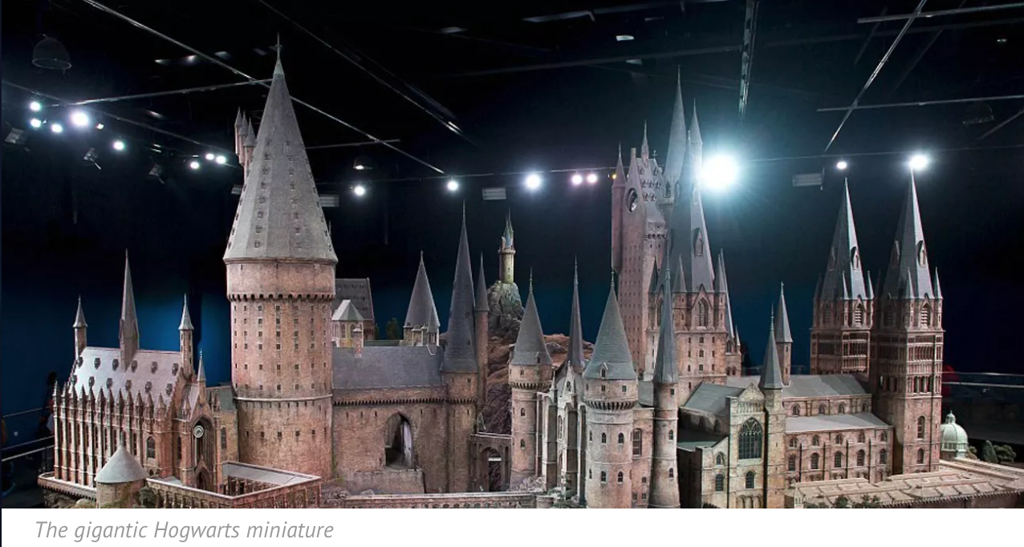
Harry Potter and the Sorcerer’s Stone (2001)- Set used for VFX

Slide 7
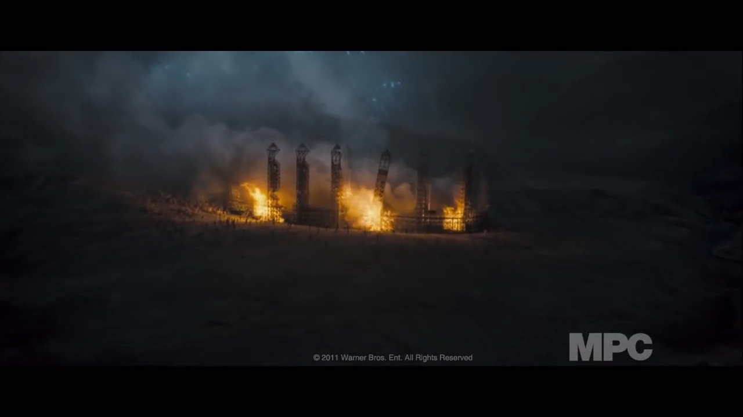
Harry Potter and the Deathly Hollows- Part 2: Visual Effects

Slide 8
Social Influence
Fan Culture turned Mainstream Culture
    made nerdy, fantasy books ‘cool’ again
    adults and children alike became huge fans of the series
    whole generation of children that were waiting for their letter from Hogwarts (including me)
Exposing millennials to philanthropic and political behaviour
    set an example of young adults opposing dominant culture and tyranny
    eg. fighting against Voldemort or Hermione advocating for equal rights for ‘non-magical creatures’ such as house-elves (eg. The House Elf Liberation Front)
A modern classic
    Shaped a whole generation (personal impact)
    Books and films alike are constantly referenced, studied, analysed
    Internationally, large enthusiastic fan base—> fanatic

Slide 9
The Harry Potter Franchise’s Influences on the Film Industry
Considered to be an American- British Film series
novels by JK. Rowling, set in England, mostly British cast but films produced and distributed by the US studio, Warner Bros.
Globally
The VFX Revolution
Harry Potter films are considered to be part of the films that ‘changed the game’ in terms of visual effects within the whole film industry (not just Britain)

Slide 10
Impact on British Film Industry
Social critique- even though most of the creative minds behind Harry Potter are British, the dividends from the profits are reaped in California where the Warner Bros is located.
Nonetheless, the British economy also profited from the series
    films shot in the UK- generated stable long-term employment, income, investment into regular and film-making infrastructure, fan-based tourism
    advanced the development of the British special effects industry and it’s technologies
        visual effects houses such as Double- Negative, Cinesite and Framestore prospered due to Harry Potter
        Double- Negative firm managing director, Alex Hope claims "Over the ten years that British companies have been working on the franchise, the UK has been transformed into a world leader in the VFX field.”
    Establishment of relationship with Warner Bros
        bringing other productions to the UK
        promotion of British film market to other international studios too

Slide 11
The Legacy Lives On
Last Harry Potter film, Harry Potter and the Deathly Hollows- Part 2 released in 2011
Spin- off prequel series Fantastic Beasts and Where to Find Them (2016) + Fantastic Beasts: The Crimes of Grindelwald (2018) + 3 more films to come from the Fantastic Beasts Franchise
      —> creation of shared fictional universe = The Wizarding World
Play in London- Harry Potter and the Cursed Child (Part 1 + 2)
Theme Parks and Merchandise
Yearly Harry Potter ‘marathons’ on TV and theatres + anniversary celebrations
JK Rowling is compared to George Lucas
    Fantastic Beasts primarily came into existence to further answer questions about an already very complete book series—> like the prequels and special editions of Star Wars

Slide 12
Works Cited
Works cited:
https://www.imdb.com/list/ls000021718/
https://www.businessinsider.com/most-successful-movie-franchises-of-all-time-at-box-office-2018-3#2-star-wars-9097-billion-22
https://www.independent.co.uk/arts-entertainment/films/features/harry-potter-and-the-death-of-an-industry-2143873.html
https://www.theatlantic.com/entertainment/archive/2018/11/fantastic-beasts-crimes-grindelwald-review/575671/
http://screenprism.com/insights/article/how-did-the-directorial-changes-across-the-harry-potter-films-suit-the-mate
Photos:
https://www.abc.net.au/news/2017-06-26/young-harry-potter-fans/8631204
https://www.emftechnology.co.uk/flame-effects/attachment/sony-dsc-53/
https://www.businessinsider.com/harry-potter-battle-hogwarts-reverse-2016-1
https://www.moviepilot.de/movies/harry-potter-und-der-stein-der-weisen/images/684106
https://imagesvc.timeincapp.com/v3/mm/image?url=https%3A%2F%2Ffortunedotcom.files.wordpress.com%2F2017%2F06%2Fhp_movie_grosses.png&w=2200&q=70

